Slide 1
Dxcc
0
DX CENTURY CLUB

Slide 2
DXCC HISTORY
Clinton B. DeSoto – ARRL
The basic rule is simple and direct: Each discrete geographical or political entity is considered to be a country.
Criteria established in 1935, first award in 1937.
Amateur Radio halted during WW II. Returned to the air November 1945.
SINCE 1945, “TEN’S OF THOUSAND’S” DXCC AWARDS HAVE BEEN GRANTED.

Slide 3
Criteria highlights
Political Entities
Geographical Entities
Special Areas
Ineligible Areas
Deletion Criteria

Slide 4
EXAMPLE
EXAMPLE: What is an Island?
Island: A naturally formed area of land surrounded by water, the surface of which is above water at high tide. For the purposes of this award, it must consist of connected land, of which at least two surface points must be separated from each other by not less than 100 meters measured in a straight line from point to point. All of the connected land must be above the high tide mark, as demonstrated on a chart of sufficient scale. For the purposes of this award, any island, reef, or rocks of less than this size shall not be considered in the application of the water separation criteria described in Part 2 of the criteria.

Slide 5
more CRITERIA RESULTS
Kure (KH7K), MIDWAY (KH4), AND HAWAI (KH6).
East Germany
Singapore and Hong Kong
St. Pierre & Miquelon
Kingman Reef and Palmyra islands.

Slide 6
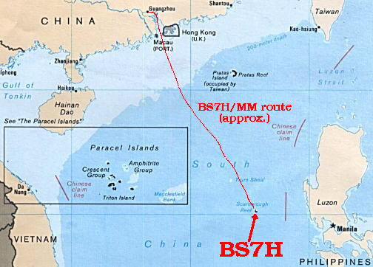
SCARBORROUGH REEF

Slide 7
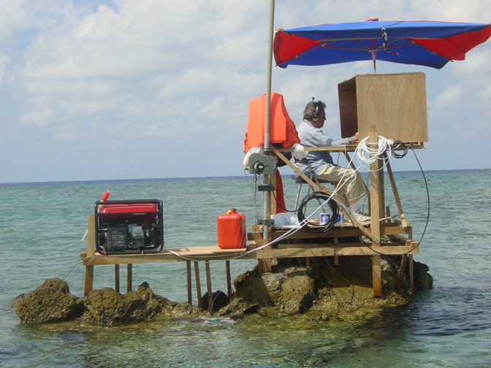
ARE DX-ers really crazy?

Slide 8
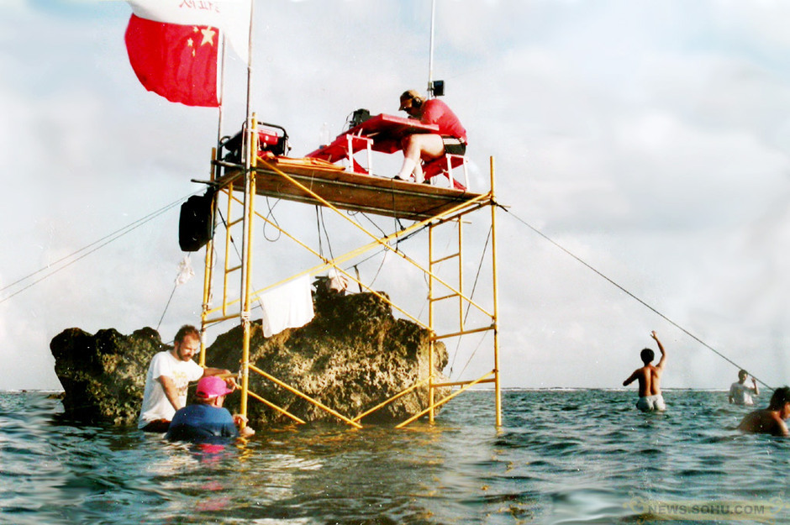
Yes, they are!

Slide 9
THE LIST
63 ENTITIES ARE ON THE DELETED LIS
340 CURRENTLY ACTIVE ENTITIES LIST

Slide 10
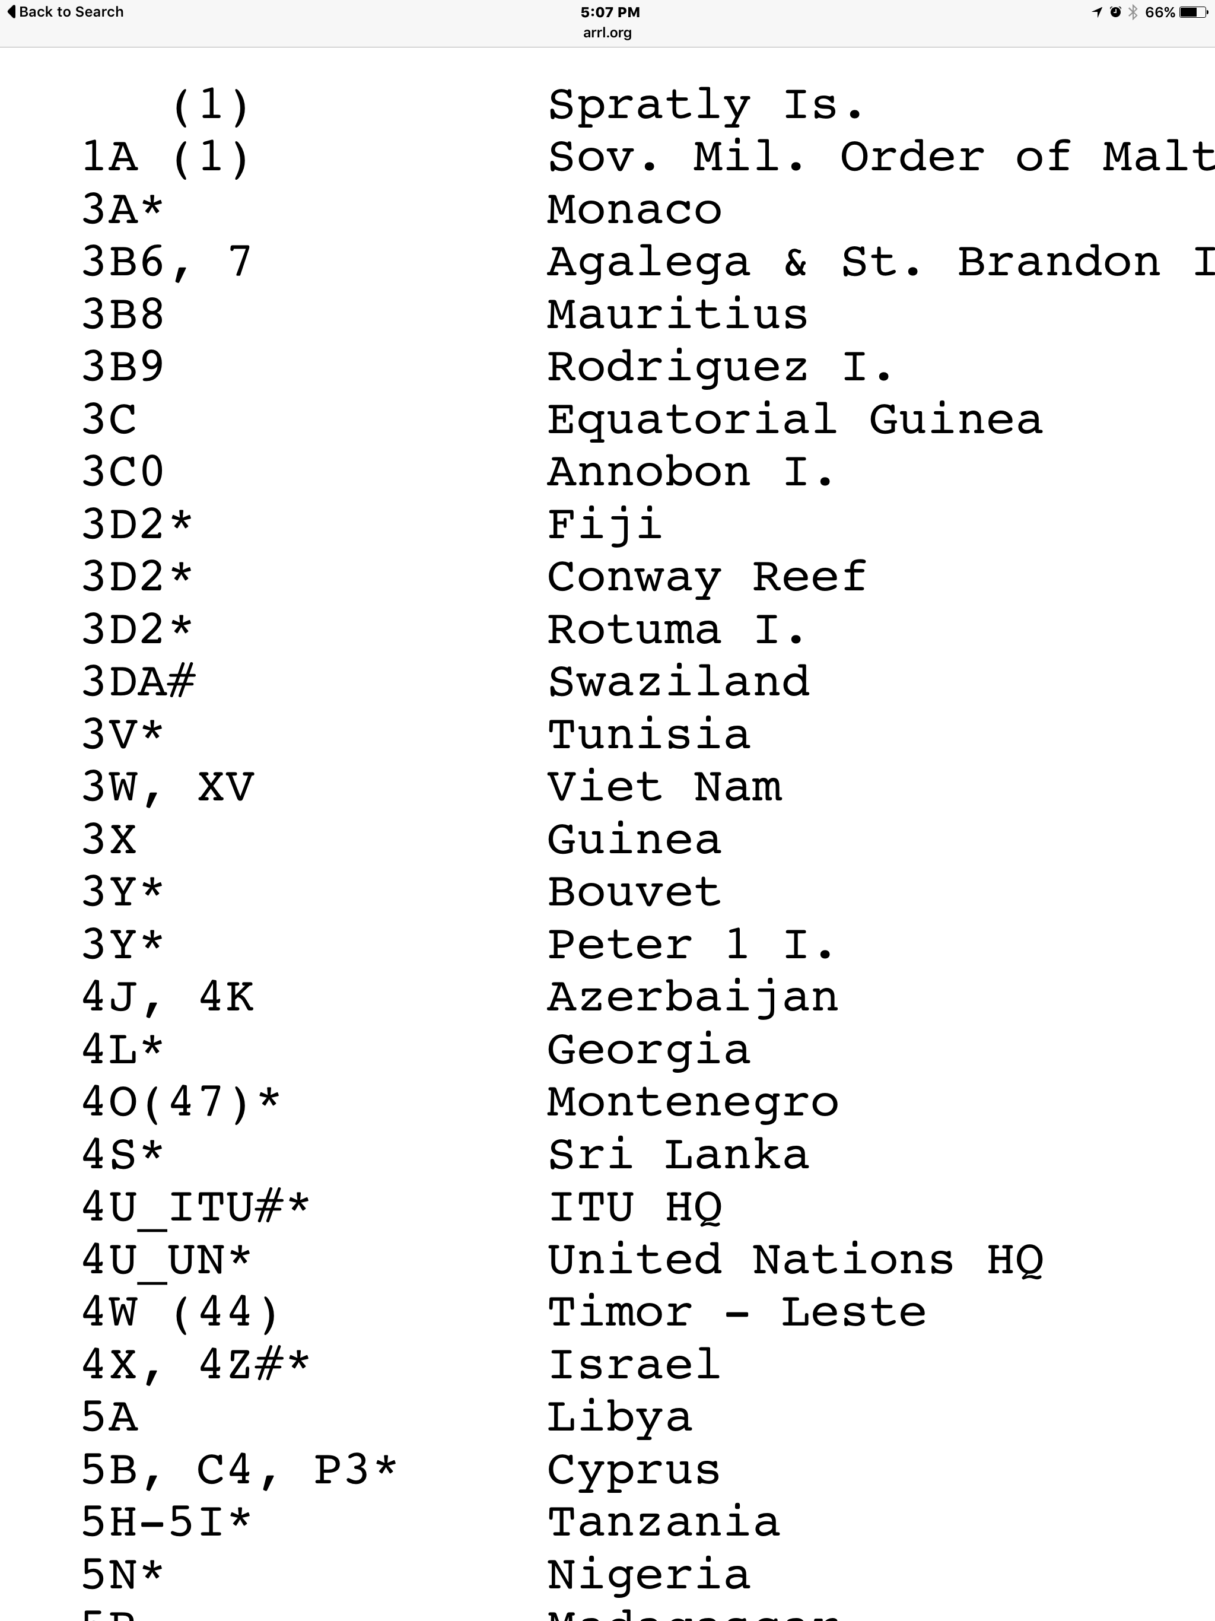
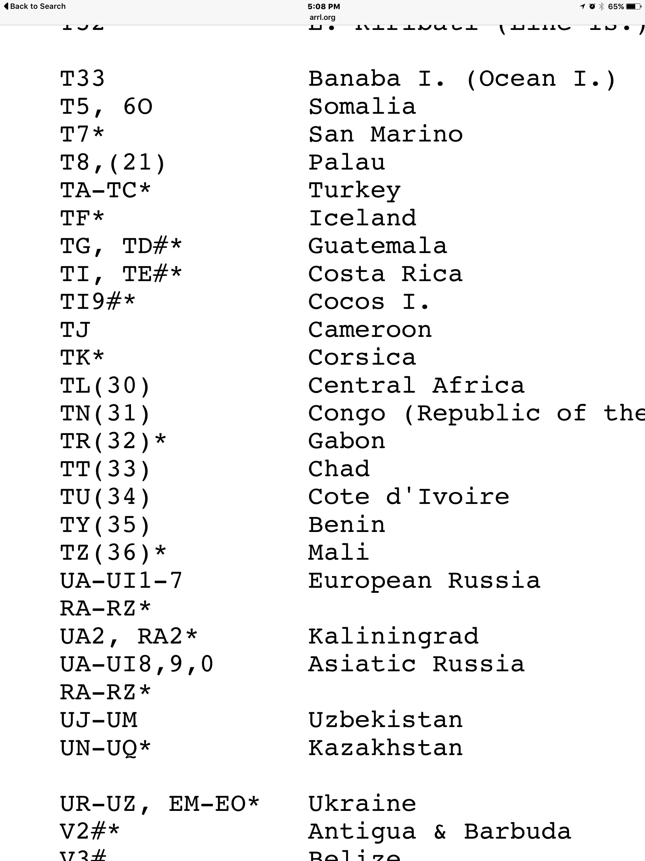
List excerpts

Slide 11
Dxcc awards basic dxcc awards
Mixed, SSB, CW, RTTY (Now DIGITAL)
Endorsements
5-Band DXCC
DXCC Honor Roll (331/340)
DXCC #1 Honor Roll
DXCC Challenge
QRP DXCC
Satellite DXCC
Toda: 337/352

Slide 12
MY LONGTIME DXCC JOURNEY
1971: STARTED TRACKING & QSL GATHERING
MARCH 18, 1974: DXCC # 14,174
JULY 9, 1985: 5 BAND DXCC # 1914
1989 HONOR ROLE
FEB 2002 QRP DXCC

Slide 13
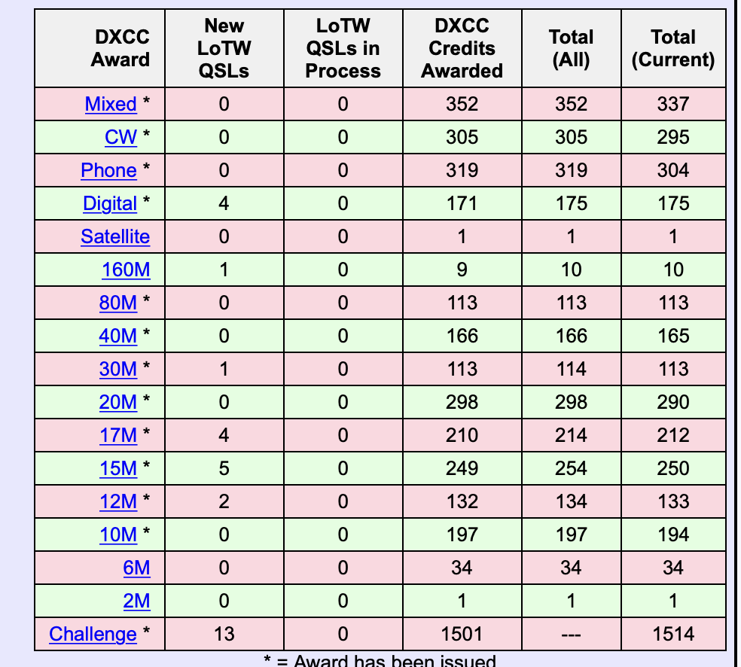
LOTW DXCC SUMMARY

Slide 14
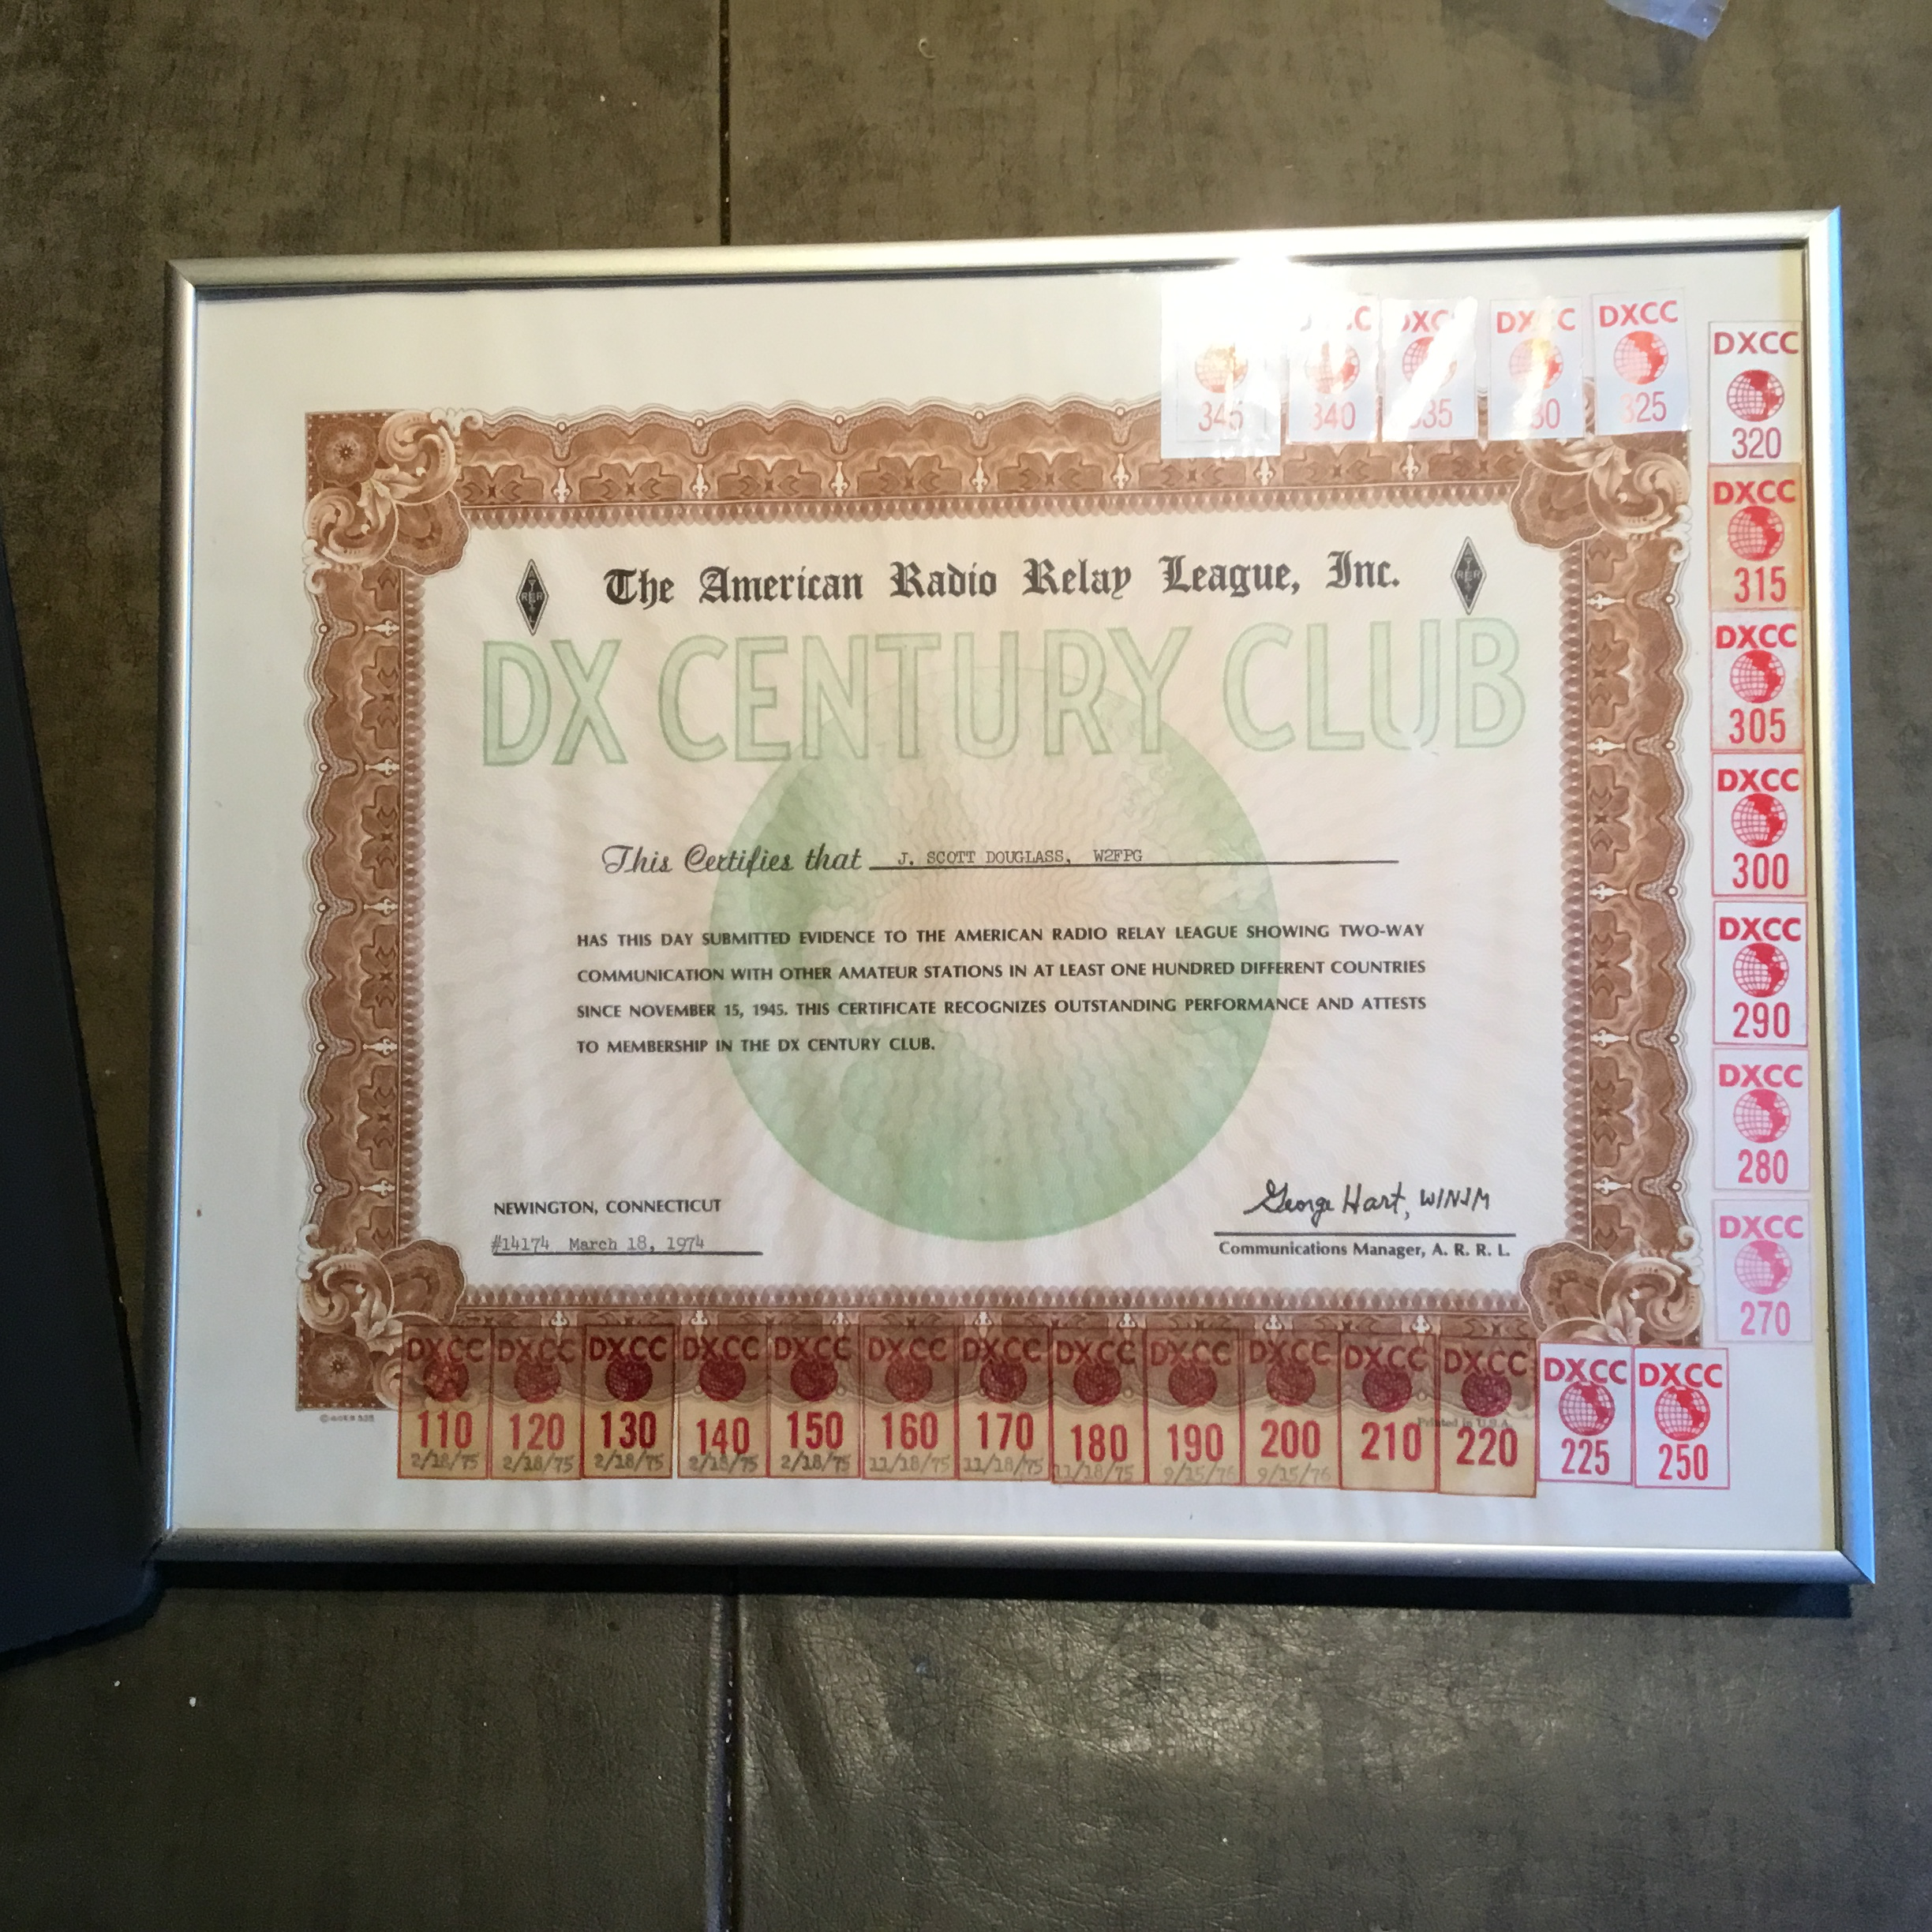
My Favorites

Slide 15
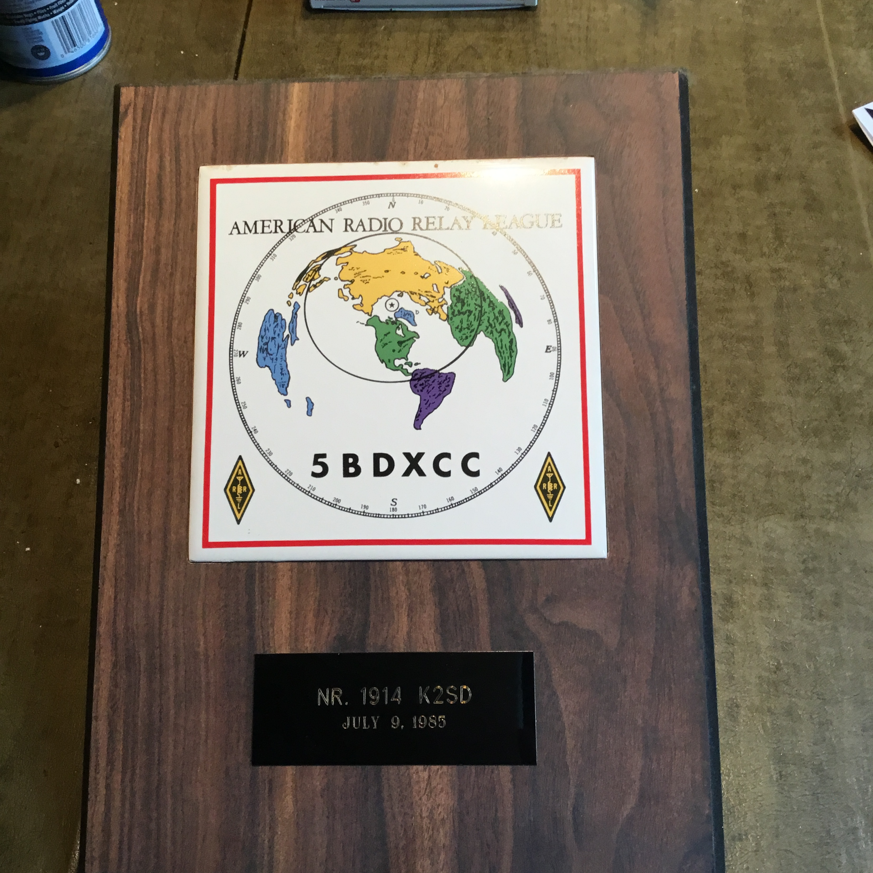

Slide 16
