Slide 1
Long Island CW Club
WARC Presentation
July 2025
Rob Thompson
KQ4OYC

Slide 2
Agenda
History
Curriculum Development
Teaching Methods
Resources
More than CW

Slide 3

Disclaimer …
Notes:
This is a report on what LICW offers and their techniques. It is not a comparison with other clubs, systems, etc,
I’m not claiming that LICW is the best. Look on the internet and there are plenty of classes, clubs, videos, podcasts, etc.
If you want to learn Morse code then find the system and class that works for you.
Some of the principles used by LICW are no doubt adopted by other classes and clubs.
I happened upon LICW early in my CW quest, was satisfied with what I found and have not investigated other options.
No claim is made that the techniques and resources discussed here are unique to LICW.

Slide 4
But first …

Slide 5
The Beginning
Let’s listen to Howard WB2UZE

Slide 6
Curriculum Development
Consult available publications and literature
Use what worked, discard what didn’t
Need student success rate > 30%
Instructor feedback important for student progress
  No automated app
Add a dose of Farnsworth for beginners
Develop tools for class and practice outside of classroom
Carousel system
Notes:
There was a lot of interest from the 20s to 50s , from both a military and commercial standpoint on effective teaching methods of Morse code. So, some of the people from LICW went back and dug out the original articles and papers to gleam from them any hints on the best ways to proceed. One paper, in particular, was written in 1936 by Koch It was however in very formal academic German and even after professional translation was difficult to read. But they persisted and wove in some of the Koch methods into LICW curriculum,

Slide 7
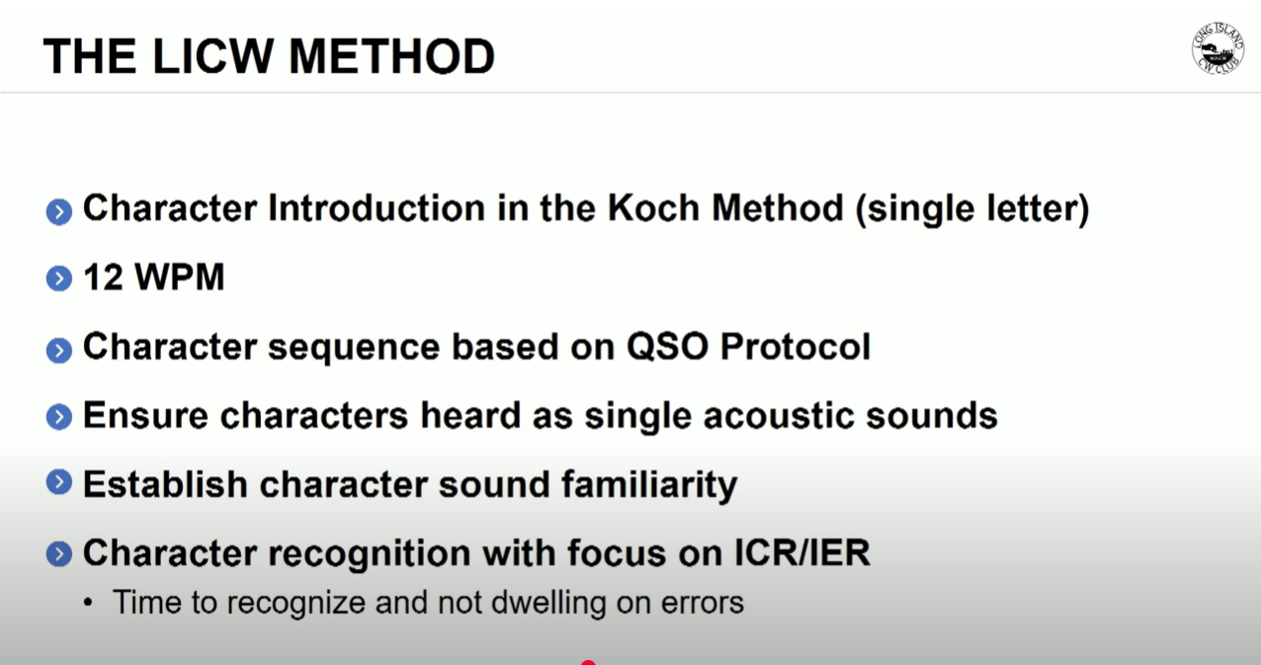
ENGAGING THE AUDIENCE
Make eye contact with your audience to create a sense of intimacy and involvement
Weave relatable stories into your presentation using narratives that make your message memorable and impactful
Encourage questions and provide thoughtful responses to enhance audience participation
Use live polls or surveys to gather audience opinions, promoting engagement and making sure the audience feel involved
Notes:
ICR stands for Instant Character recognition – knowing the character by the complete sound without having to break it down into dits and dahs
IER is Instant Error Recovery – if a character doesn’t come to you you have to develop the knack of just letting it go by instead of dwelling on it. If you keep trying to decode the character you din;t get a first you will rapidly fall behind and miss the rest of the message.

Slide 8
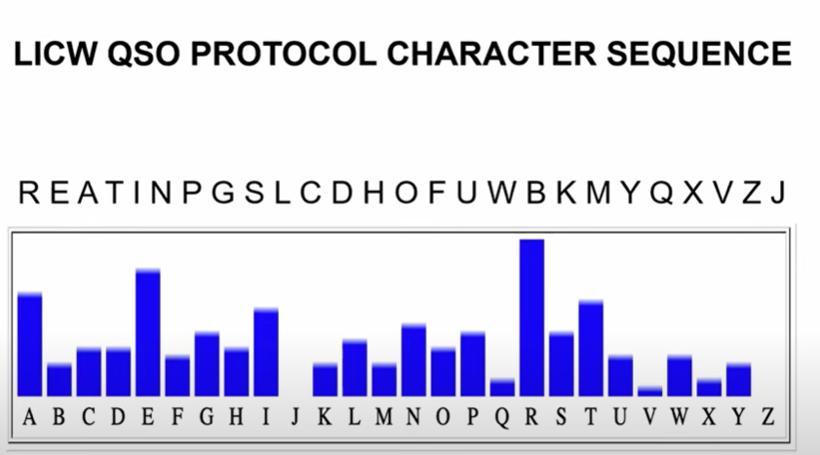
QSO Letter Frequency
Notes:
Another method LICW adopted was to do a character analysis of actual QSOs with the idea of introducing the characters most frequently used early in the character learning sequence.

Slide 9
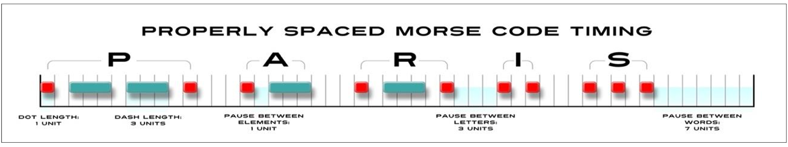
Spacing
“Give me a break – I’m new at this!”
Farnsworth to the call
Notes:
Let’s talk about spacing of characters and Farnsworth.
So , the proper spacing of CW is – if a dit is one unit of time then a dah should be 3 units and within in a single character there should be 1 unit of space (empty air) between the dits and dahs.
Between characters there should be 3 units of space and between words there should be 7 units of space.
The Farnsworth technique is to add a little extra spacing between characters and between words with the idea that this can give the beginner a little help in comprehension. The idea is credited to
Donald R. “Russ” Farnsworth, W6TTB, SK. Who puzzlingly did not use that method in his own teaching.
Farnsworth as adopted by LICW is used in beginning classes to give the student a little help in “Instant Character recognition – ICR”. You will see code speeds in tools and texts given as xx/yy where xx is the single character speed and yy is the overall word speed - for example 14/10 where the first number represents the speed of individual characters and the second number represents the overall speed of the word or phrase once a little of spacing is added inter character and inter word.
The goal of course is as proficiency is obtained, the additional spacing is cut down until a student is receiving and sending at xx/xx.

Slide 10

WITHOUT FARNSWORTH
WITH FARNSWORTH
Notes:
The fist audio is “Paris is the city of light” at 16 wpm with no Farnsworth spacing, Therefore we say 16/16
The second audio is the same sentence with spacing added between characters and words. It is 16/12
It’s important to note that within a character there is never in additional spacing. For example the Ps in both samples were delivered at the same speed – 16 wpm.

Slide 11
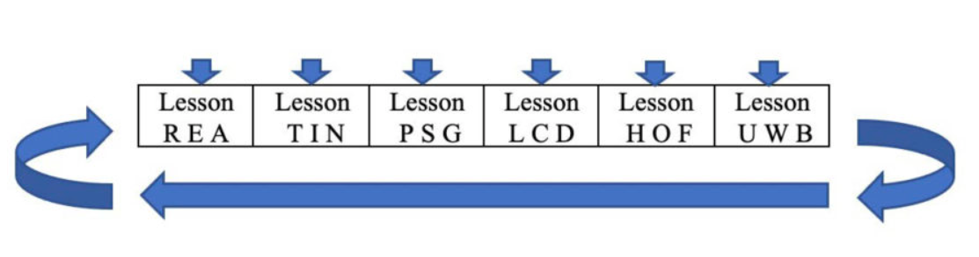
Beginner's carousel 1
18 characters in 6 lessons
Notes:
So in Beginners Carousel 1, or BC1 as we call it, Each class is a 1 hour , instructor led, session on zoom. In the first half hour the new characters are introduced. In the second half hour the characters from preceding sessions are reviewed along with the new characters. There will be multiple BC1 sessions in a given week – all on the same lesson. Thus for example, if you usually attend a BC1 on Tuesday at 8PM and miss then pick up the same lesson by a different instructor on maybe Thursday or Saturday.
It takes 6 weeks to go thru the whole BC1 lesson set. Then the whole sequence starts over. Still a little shakey – go around again. That’s why it’s called a carousel.

Slide 12
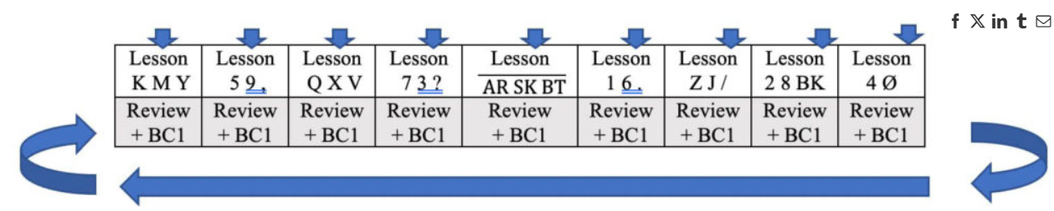
Beginner's carousel 2
26 characters in 9 lessons
Notes:
Beginners Carousel 2 is a similar format. Each week for 9 weeks the remaining letters, 10 numbers, prosigns, and punctuation are introduced – 3 new symbols each week in the first half of the hour-long lesson, The second have is a review of all material covered to date. In a given week all BC2 classes cover the same lesson. Miss your usual class early in the week – pick it up later in the week. Get through all nine classes of BC2 and still not confident – go around again. That’s why it’s called the carousel system. When do you exit BC2 – whenever you feel you are ready.
Everyone know what a prosign is – letters sent with no spacing between them as a single character to carry a specific meaning. <AR> for example is end of message
<AR> = End of message
<SK> = End of contact
<BT> = Pause or separator

Slide 13
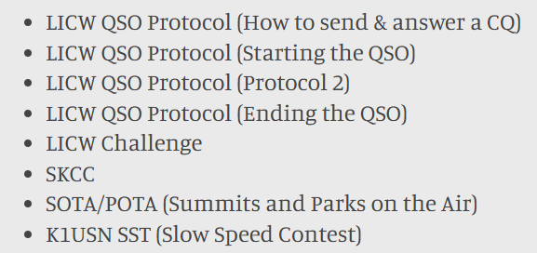
BEgginers carousel 3 eight lessons to Prepare for on-air
Notes:
BC3 is devoted to preparation for getting on the air by listening and sending various QSO protocols and discussion about where to find a participate in
Beginner friendly QSOs.

Slide 14
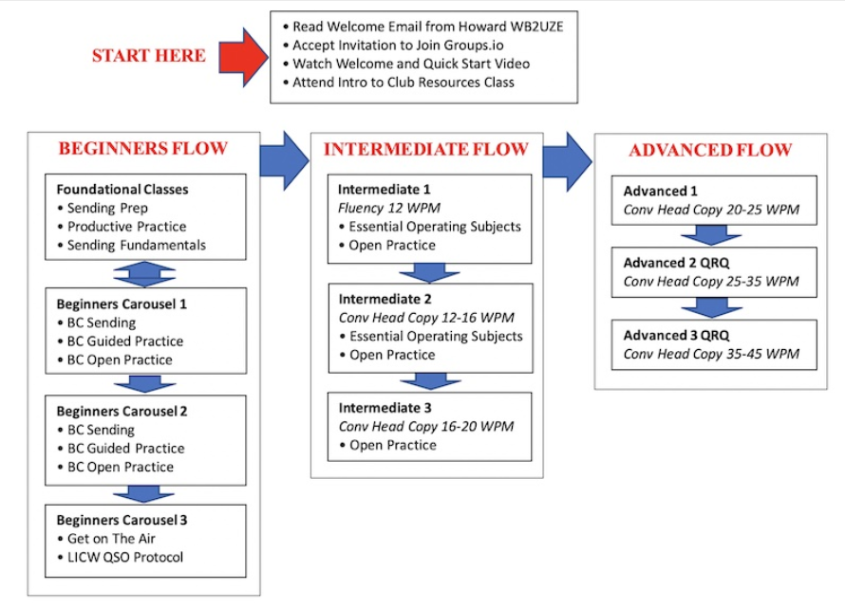

SPEAKING IMPACT
Your ability to communicate effectively will leave a lasting impact on your audience
Effectively communicating involves not only delivering a message but also resonating with the experiences, values, and emotions of those listening

Slide 15
Classes
5 Zoom rooms A thru E
Early morning to late night
Classes Repeated throughout the week
Spanish Language Classes
YL only Classes

Slide 16
Calendar
Notes:
So as a student you will have access to the LICW calendar which shows when the various classes and sessions are held on which zoom room. There are 5 zoom rooms available and classes run from early morning to late at night. Nearly all the CW classes are repeated throughout the week. Non-CW special interest sessions are typically once a week.

Slide 17
LICW Practice Page
Notes:
The Practice page is a web-based page that is used by instructors in class and by students for their own practice outside of class. The letter sequence of BC1 and BC2 is built into the practice page. We’ll not have time to go over all the options of this page. There are many and if you take up LICW you will be spending a lot of time here.

Slide 18
LICW Guiding Principles
Proceed thru classes at your own pace
One or two classes a week, practice 30-60 min daily in 2 sessions
Code talk when not at your key
Practice no slower than 12 wpm
Learn characters by the sound (no charts or visual clues)
Complete beginners should start with a straight key
Strive for ICR - Instant Character Recognition
Strive for IER – Instant Error Recovery
Class is class, practice is PRACTICE
Notes:
So, here’s another take on the LICW method and what they emphasize in the learning of Morse Code.

Slide 19
CODE TALKING
A way to practice away from your key
Vocalize the characters as dits and DaHs
(as they sound)
NOT as dots and dashs
For example – NC
Dah dit dah dit dah dit
Notes:
And just a brief word about code talking…

Slide 20
More than CW
Antenna forum
Elmering
Basic Electronics
3D printing
Maker's forum
Wild About Bugs
National Traffic System training
POTA / SOTA forum
Boat Anchor forum
Notes:
LICW offers more than Morse Code. There are plenty of sessions and classes on topics not strictly CW related. The Electronics class was very useful when I was studying for the Extra exam.

Slide 21
Recent LICW Stats
> 6000 Members
100 instructors
All 50 States and 60 Countries represented
Classes in
  English
  Spanish
Dues:
  $30 / Year
  $90 / Lifetime

Slide 22
More Info
LICW web site:
Learn Morse Code - CW with The Long Island CW Club
LICW Welcome Video
The LICW Method
LICW Presentation at Dayton 2025:
LICW and Renaissance of Morse Code

Slide 23
Fin – Questions?
Rob Thompson
KQ4OYC
almogavars@gmail.com

Slide 24
Thank you
73

